Slide 1


Slide 2

CAT T3 Design
Arun Rajayogan

Slide 3
User Input
Get all 4 vertices
Check if they are invalid (duplicates or simply not making any sense i.e a letter in the coordinate), if invalid keep on asking for correct input until valid
Convert all the vertices to tuples, then add the tuples to a list

Slide 4
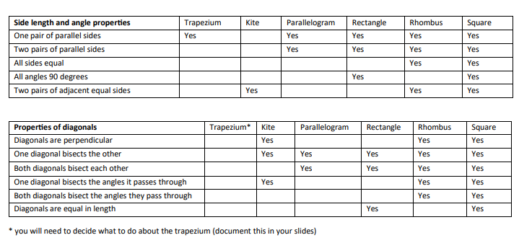
Properties

Slide 5
Properties
Each shape (square, rhombus, rectangle etc.) will have its own set of properties, its own data.
Two sets of data, one for sides and one for the angles.
If the properties of the inputted shape match up, then the match is outputted.
This allows more shapes to be added to the “database(s)” making it very versatile for future use.
A separate function will exist for each property in order to perform multiple simple checks, this makes it more plug and play and so more modular.

Slide 6


Important
Most properties in the table are built from previous properties.
Only a small amount of actual math would be done.
Helps make everything very modular by approaching it this way.

Slide 7
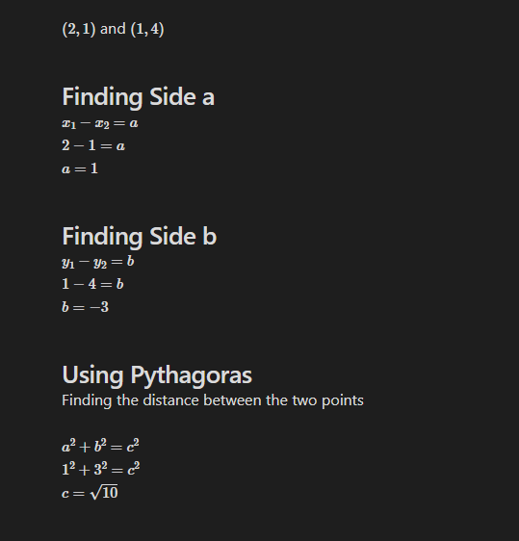
Side Lengths

Slide 8
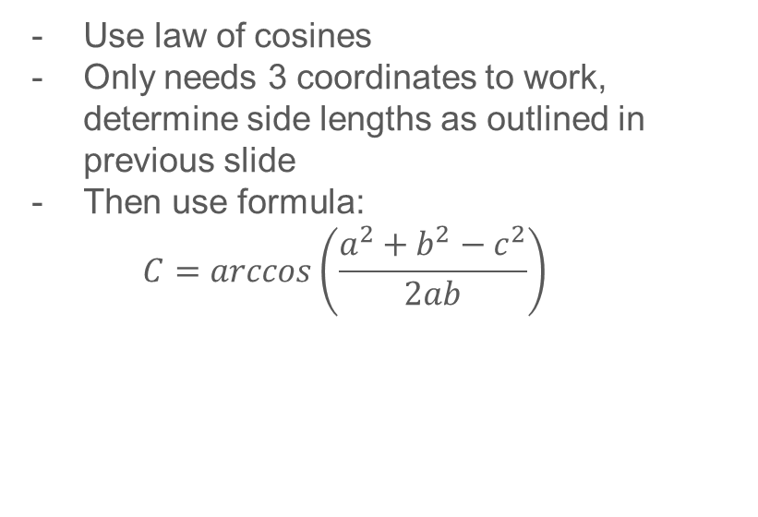
Side Lengths
Use law of cosines
Only needs 3 coordinates to work, determine side lengths as outlined in previous slide
Then use formula:
$$C=arccos\left(\frac{a^{2}+b^{2}−c^{2}}{2ab}\right)$$

Slide 9
Vertices Sort
1
Use first point entered
2
3

Slide 10
Vertices Sort
1
2
Finds greatest angle between all other points
3

Slide 11
1
Vertices Sort
2
3
4th not included point after finding the angle is furthest vertices from starting point.

Slide 12
Sorting Points (In Depth)
Get the first point given in the input. This is will point A for simplicity.
From point A cast a ray to all other point.
Now 3 lines are formed, find 3 angles
As these can only be convex shapes, not concave, the angle which is greatest forms one corner of our shape.
The non-included point is opposite to point A, and is labelled point C
The other two points are B and D, not important which is which.
Appended into a list in the correct order

Slide 13

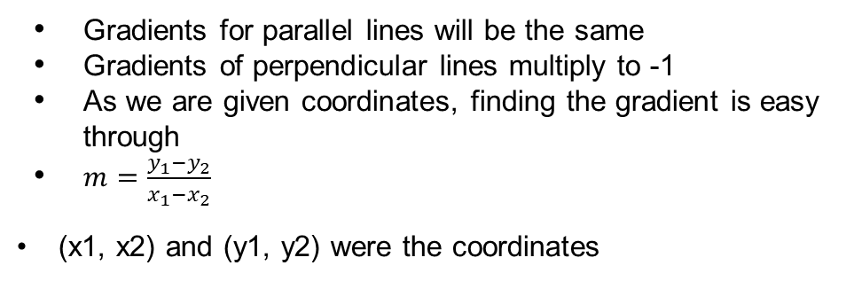
Parallel and Perpendicular Lines
Gradients for parallel lines will be the same
Gradients of perpendicular lines multiply to -1
As we are given coordinates, finding the gradient is easy through
$m=\frac{y_{1}−y_{2}}{x_{1}−x_{2}}$
(x1, x2) and (y1, y2) were the coordinates

Slide 14
THE TRAPEZIUM!

Slide 15
THE TRAPEZIUM!
The definition of a trapezium is that it has one pair of parallel sides, a general trapezium has nothing to do with its diagonals.
So, it won’t be represented in terms of its secondary properties, unless of course we start to include trapezium sub-types, such as the isosceles trapezium.

Slide 16
shape_check_1 = {"square": ["1_parallel", "2_parallel", "all_sides_equal", "all_angle_90", "2_pair_equal_adjacent_side"],
"rhombus": ["1_parallel", "2_parallel", "all_sides_equal", "2_pair_equal_adjacent_side"],
"rectangle": ["1_parallel", "2_parallel", "all_angle_90"],
"parallelogram": ["1_parallel", "2_parallel"],
"kite": ["2_pair_equal_adjacent_side"],
"trapezium": ["1_parallel"]}
shape_check_2 = {"square": ["perpendicular_diagonals", "1_diagonal_bisect_other", "2_diagonal_bisects_others", "1_bisect_angle", "2_bisect_angles", "diagonals_equal_length"],
"rhombus": ["perpendicular_diagonals", "1_diagonal_bisect_other", "2_diagonal_bisects_others", "1_bisect_angle", "2_bisect_angles"],
"rectangle": ["1_diagonal_bisect_other", "2_diagonal_bisects_others", "diagonals_equal_length"],
"parallelogram": ["1_diagonal_bisect_other", "2_diagonal_bisects_others"],
"kite": ["perpendicular_diagonals", "1_diagonal_bisect_other", "1_bisect_angle"],
"trapezium": []}
###Respective output for each property
prop_1 = {"1_parallel": "One pair of parallel sides", "2_parallel": "Two pairs of parallel sides", "all_sides_equal": "All sides equal", "all_angle_90": "All angles 90 degrees", "2_pair_equal_adjacent_side": "Two pairs of adjacent equal sides"}
prop_2 = {"perpendicular_diagonals": "Diagonals are perpendicular", "1_diagonal_bisect_other": "One diagonal bisects the other", "2_diagonal_bisects_others": "Both diagonals bisect each other", "1_bisect_angle": "One diagonal bisects the angles it passes through", "2_bisect_angles": "Both diagonals bisect the angles they pass through", "diagonals_equal_length": "Diagonals are equal in length"}
Code Underlying Idea
The code builds up the properties of the unknown quadrilateral.
Check if the built-up list of properties matches any of the properties we are testing for (square properties, rectangle properties etc.)
Then output what shape is matched with the unknown quadrilateral

Slide 17
Code Underlying Idea
shape_check_1 = {"square": ["1_parallel", "2_parallel", "all_sides_equal", "all_angle_90", "2_pair_equal_adjacent_side"],
"rhombus": ["1_parallel", "2_parallel", "all_sides_equal", "2_pair_equal_adjacent_side"],
"rectangle": ["1_parallel", "2_parallel", "all_angle_90"],
"parallelogram": ["1_parallel", "2_parallel"],
"kite": ["2_pair_equal_adjacent_side"],
"trapezium": ["1_parallel"]}
shape_check_2 = {"square": ["perpendicular_diagonals", "1_diagonal_bisect_other", "2_diagonal_bisects_others", "1_bisect_angle", "2_bisect_angles", "diagonals_equal_length"],
"rhombus": ["perpendicular_diagonals", "1_diagonal_bisect_other", "2_diagonal_bisects_others", "1_bisect_angle", "2_bisect_angles"],
"rectangle": ["1_diagonal_bisect_other", "2_diagonal_bisects_others", "diagonals_equal_length"],
"parallelogram": ["1_diagonal_bisect_other", "2_diagonal_bisects_others"],
"kite": ["perpendicular_diagonals", "1_diagonal_bisect_other", "1_bisect_angle"],
"trapezium": []}
###Respective output for each property
prop_1 = {"1_parallel": "One pair of parallel sides", "2_parallel": "Two pairs of parallel sides", "all_sides_equal": "All sides equal", "all_angle_90": "All angles 90 degrees", "2_pair_equal_adjacent_side": "Two pairs of adjacent equal sides"}
prop_2 = {"perpendicular_diagonals": "Diagonals are perpendicular", "1_diagonal_bisect_other": "One diagonal bisects the other", "2_diagonal_bisects_others": "Both diagonals bisect each other", "1_bisect_angle": "One diagonal bisects the angles it passes through", "2_bisect_angles": "Both diagonals bisect the angles they pass through", "diagonals_equal_length": "Diagonals are equal in length"}

Slide 18
Diagonal Properties

Slide 19
Diagonal Bisection
Find the halfway point of both diagonals (find average between both points)
Check if that half way point lies on the other diagonal
For diagonal AC, let point E be the midpoint of diagonal BD. If AE has the same gradient as AC then AC bisects BD.
We apply this to AC as well.

Slide 20
Diagonal Angle Bisection
In Quadrilateral ABCD to check if AC bisects Angle BAD:
- Find Angle BAC, if BAC is half of BAD then:
- AC bisects BAD
This can also be done through splitting the quadrilateral into two triangle (for one diagonal), then check for congruency, and show that 2 equal angles make up a larger angle.

Slide 21
Modularity of the Code

Slide 22
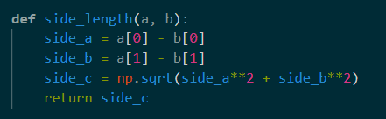

Slide 23
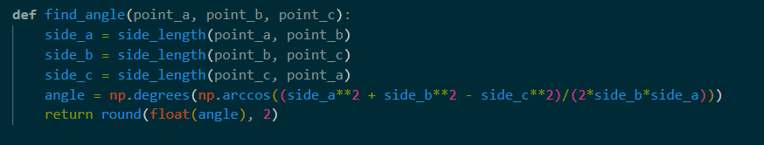

Slide 24
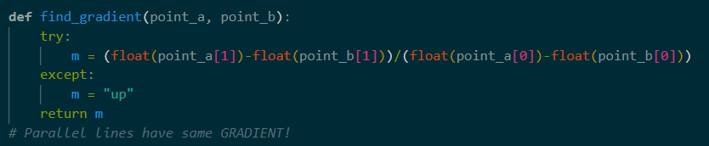

Slide 25
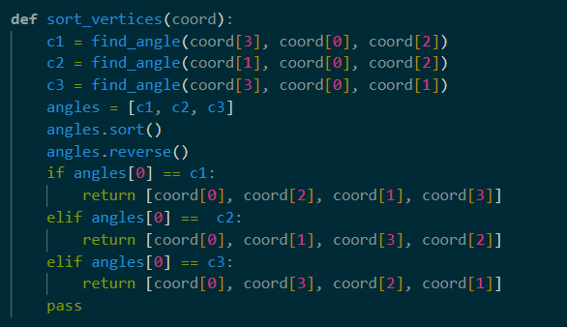

Slide 26
Questions?

